Slide 1

Decoding of motor termination in Imaged movement
Elisabetta Pagliara, Marco Milano, Giammarco Pacifico (Project 1)
Brain Computer Interaction – EE514

Slide 2

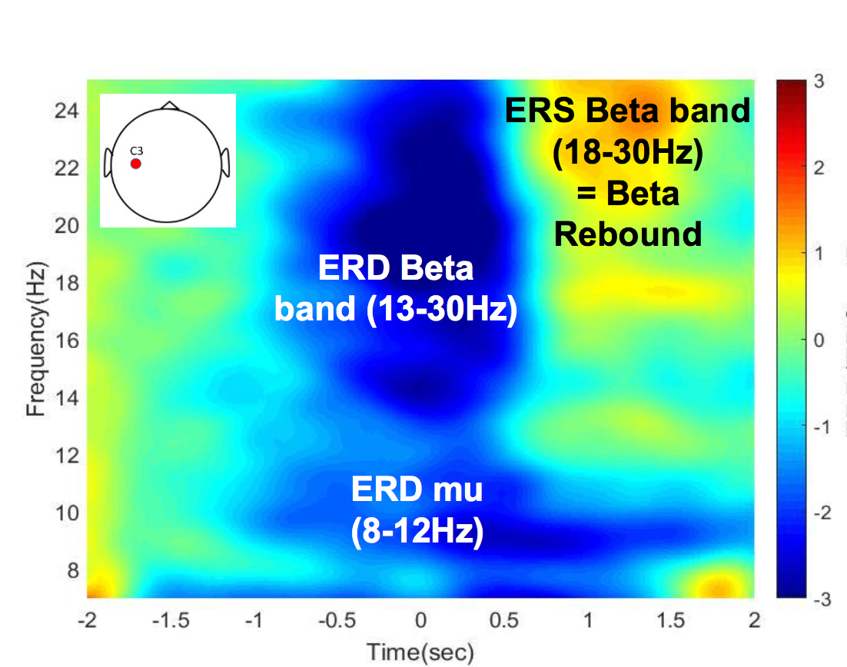
Project Description
Performing Kinesthetic Motor Imagery (MI)
What happens to the brain activity (record from 16 electrodes-cap)?
Why studying Kinesthetic MI?
Beta rebound could be used to decode when the user wants to stop motor imagery
Notes:
It has been observed that preceding movement onset and during movement execution, a decrease of power can be detected in mu band (8-12 Hz) as well as an increase of power in beta band (13-30 Hz), called beta rebound, over the contralateral sensorimotor cortex.

Slide 3
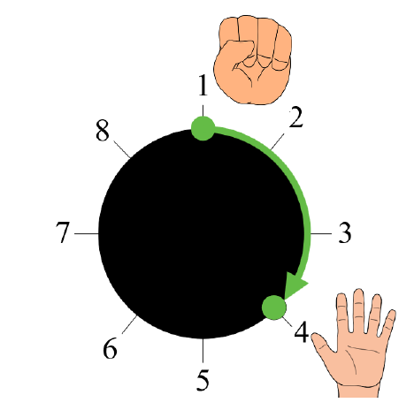
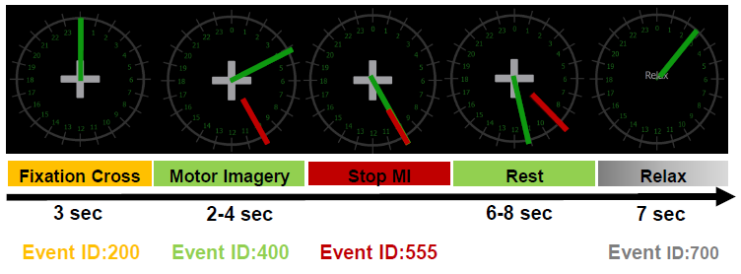
Protocol
START
END
4 runs (cue-based) of 30 trials of 10 sec plus 7 sec of relax each.
Beta rebound
Notes:
Changes in the brain rhythms are observed in the sensory-motor area of brain during planning and execution of movements. Indeed, it has been observed that preceding movement onset and during movement execution, a decrease of power can be detected in mu band (8-12 Hz) as well as in beta band (13-30 Hz) over the contralateral sensorimotor cortex (Pfurtscheller & Lopes Da Silva, 1999). Additionally, the beta band presents an increase of power known as the beta rebound, which generally occurs after movement termination and that can last for a second (Thatcher, Sato, Kufta, & Hallett, 1994). This beta rebound does not necessarily depend on motor cortex output and muscle activation since this beta rebound has been also reported in motor imagery (MI) and it is thought to reflect a short-lasting state of deactivation or inhibition of motor cortex networks

Slide 4
EEG correlates - Methods

Slide 5
EEG correlates - Methods
Concatenation of all runs for each subject
Comparison of two different spatial filters: Laplacian filter and CAR filter
Epoching of the data based on the event type and the chosen time before and after the selected event
Baseline (EventID 200): [-3 , 3] s
Motor Imagery initiation (EventID 400): [-4 , 2] s
Motor Imagery termination (EventID 555): [-3 , 3] s
Pwelch on CAR data to obtain the periodogram to compare baseline and Motor Imagery (Parameters: win=512, noverlap=0.5*512, frequency=500 Hz, sample rate=512 Hz)
Spectrogram on the most relevant channels
Grand average over the three subjects
Topoplot in alpha band (8-12 Hz) and beta band (13-30 Hz) for both onset and offset, using the a 2 seconds window [-1:0.25:1] s with respect to the event alignment

Slide 6
EEG correlates - Results

Slide 7
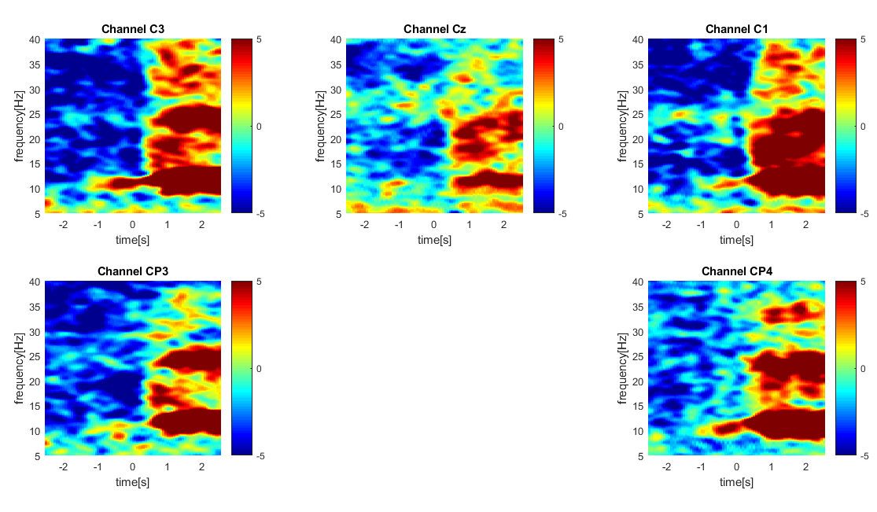
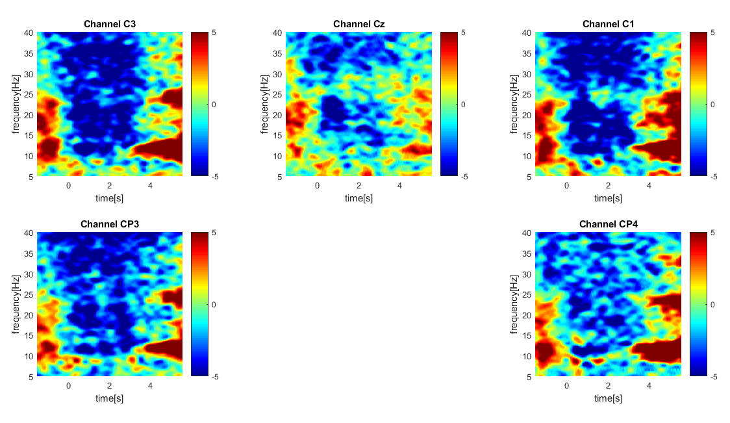
Spectrogram offset and onset CAR - ak4
The presence of the beta rebound is clearly visible for C1, C3 and CP4 but a sort of “alpha rebound” is also present at lower frequencies

Slide 8
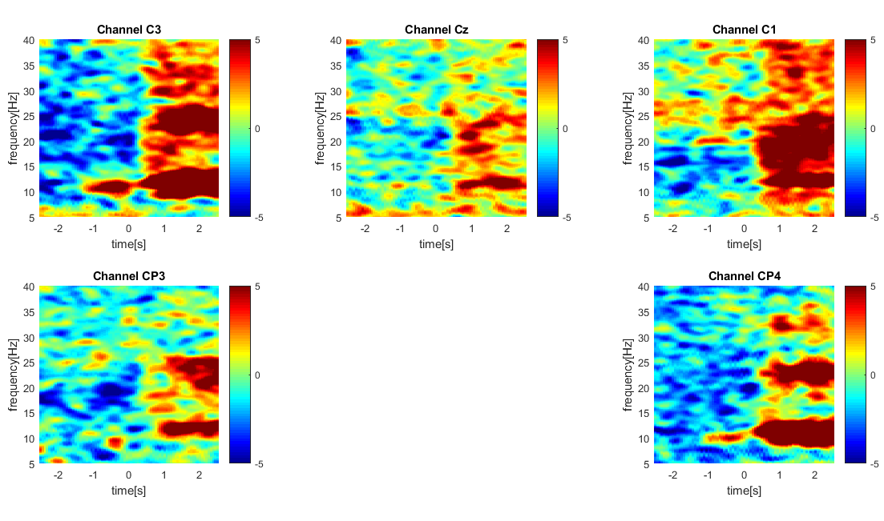
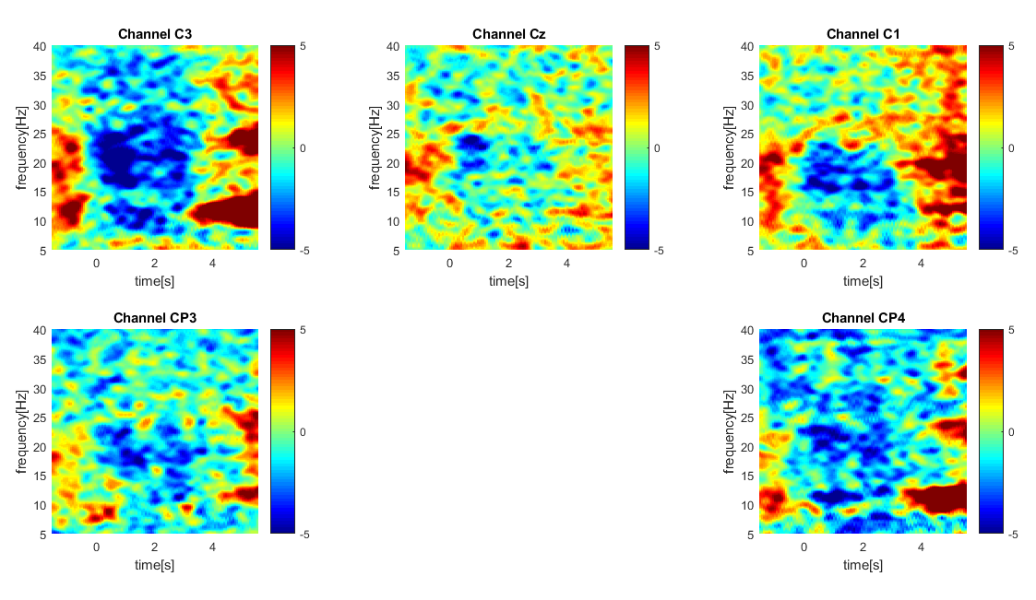
Spectrogram offset and onset Laplacian - ak4
Compared to CAR filter, Laplacian shows less evident representation of ERD events in all the channels. Therefore, CAR has been chosen for the subsequent analyses.

Slide 9
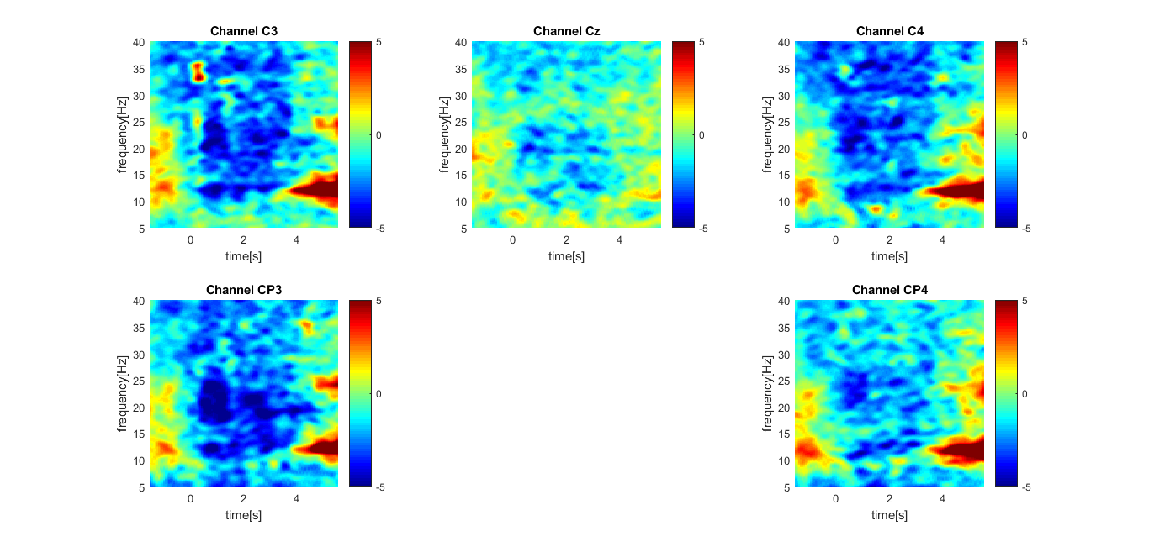
Grand average over all three students - CAR (onset)
Events (ERD in blue and ERS in red) are visible in all the grand averaged plots for onset

Slide 10
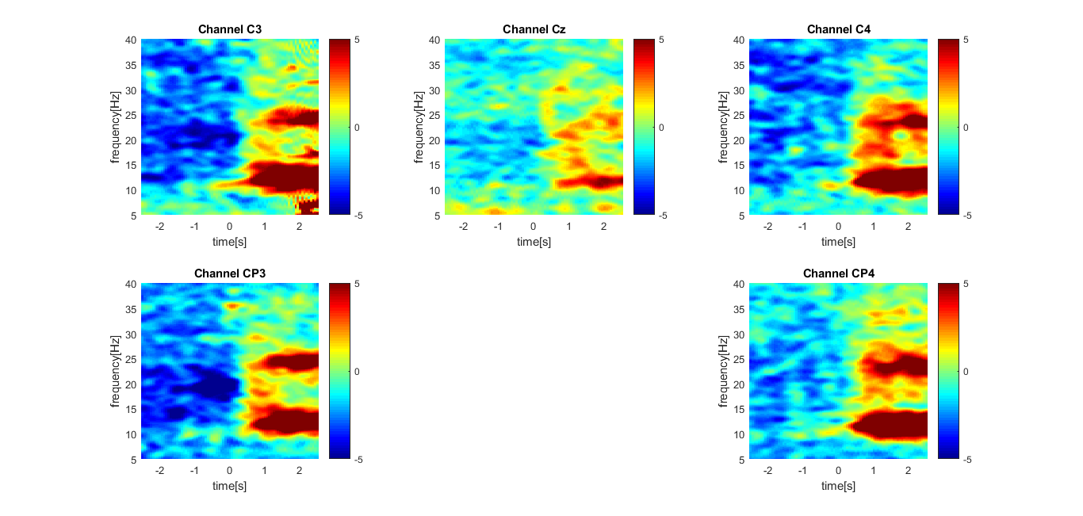
Grand average over all three students - CAR (offset)
Events (ERD in blue and ERS in red) are visible in all the grand averaged for the offset
Notes:
As expected, the beta rebound is particularly visible with the offset boundaries.

Slide 11
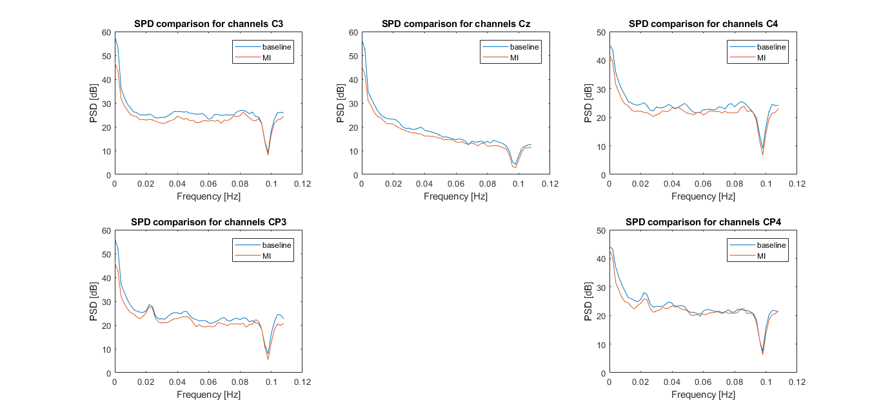
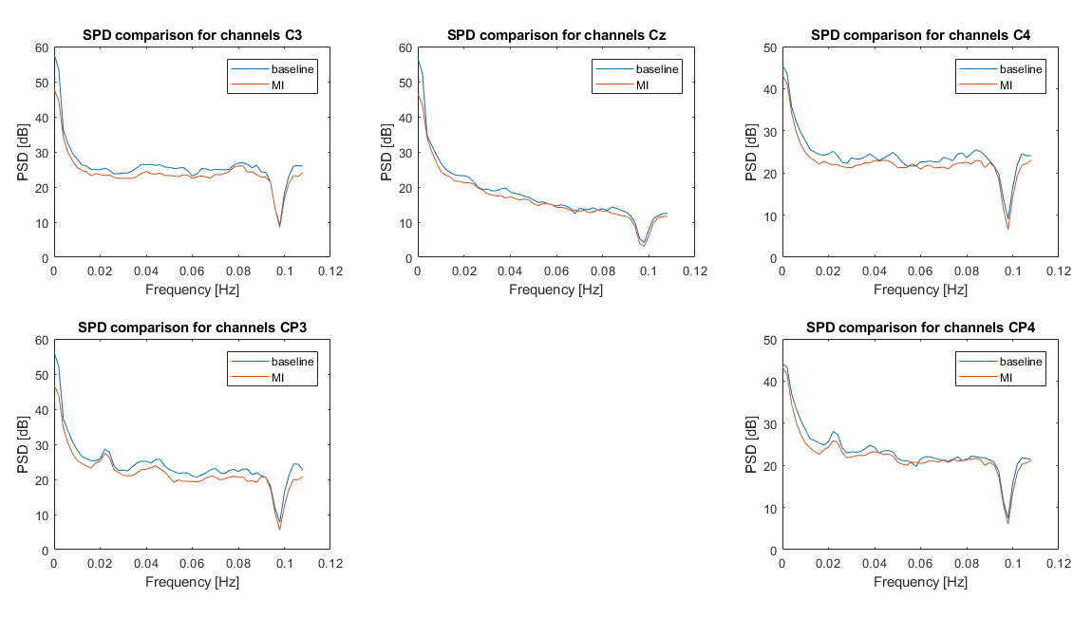
Periodogram (Pwelch) CAR offset/onset ak5
The periodogram shows the PSD depending on the frequency. We only showed the region of interest until 50 Hz. The presence of two bumps in the alpha band can be seen in the most relevant channels when comparing baseline and MI

Slide 12
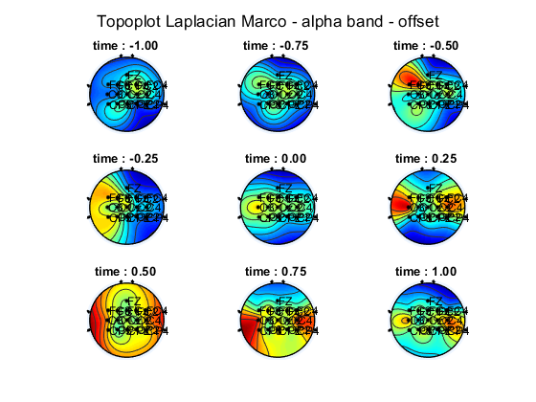
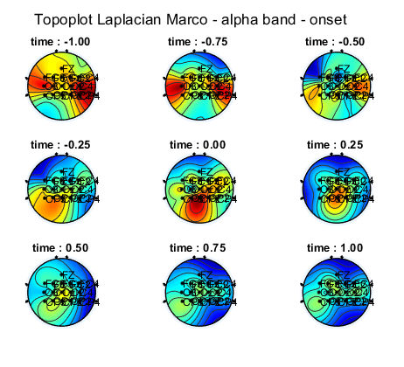
Topoplot alpha band - ak4
A decrease in the alpha band can be observed after the onset alignment and during the motor imagery. Moreover, a considerable increase is visible after the MI termination, during the relax phase

Slide 13
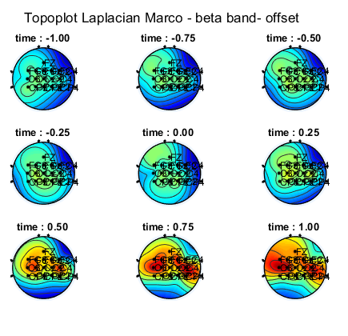
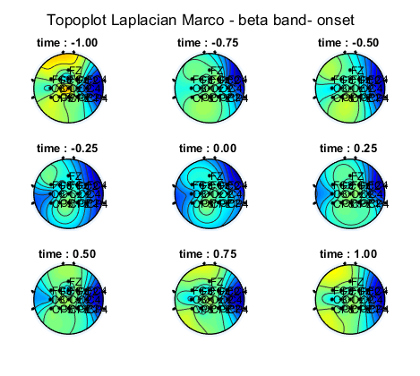
Topoplot beta band - ak4
The presence of the beta rebound is evident after the MI termination while lower power is visible during the MI initiation

Slide 14
Pattern Classification - Methods

Slide 15
Structuring the data
4 runs (4 ∙ 30 = 120 trials) per subject
Spatial filtering: CAR. Temporal filtering: /
Spectrogram on the whole signal (for each run)
[4:2:40] Hz (19 intervals)
16 channels
Division of the signal into 1 second-long windows with a shift of 0.0625 s
=> 304 different features (PSD)

Slide 16
Structuring the data (2)
Epoching on :
Motor Imagery Initiation - Event ID 555 [ -2,0 ] s
Motor Imagery Termination - Event ID 555 [ 0.5,2.5 ] s
We obtained 17 windows for each trial for each type of event (i.e. 17 ∙ 2 = 34)
Concatenation of the runs
=> 120 ∙ 34 = 4080 samples with 304 features
Classifier had to distinguish between two classes: ERD (MI initation) and ERS (MI Termination)
(Manually (re)assigned label 400)

Slide 17
Methods Classifier
Divided into 75% training - 25% testing
CV on training but with temporal…. partition
Normalization with zscore on training folds and “projection” on validation folds
We tried PCA but didn’t get good results
Hyperparameters:
Type of classifier (linear, diaglinear, diagquadratic)
Number of features (we tried from 1 to 304 but in the end chose among 1:20)
(Number of PCs => 0)
=> Feature selection with Fisher’s score
=> Hyperparameter selection based on class error (of course on validation fold!) averaged over folds

Slide 18
Evaluation of the capability
Retraining on the whole 75% training + validation set (but without CV), with the hyperparameters found in the CV
For features: only the number of features is fixed, but the actual features to take into account are determined by re-training
=> Test on the separate unseen 25% test set
Metrics:
- ROC curve
- confusion matrix
- class error

Slide 19
Pattern Classification - Results

Slide 20
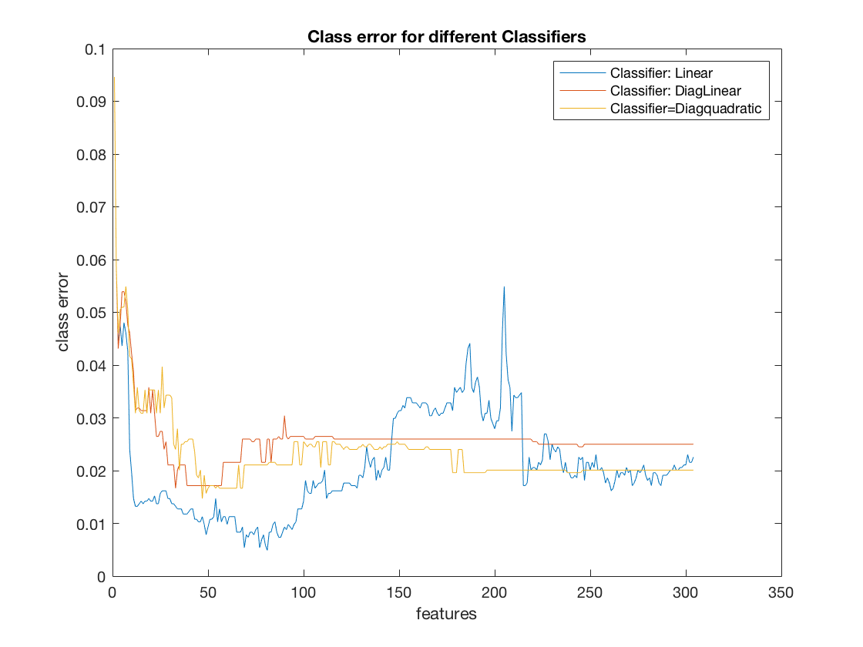
Hyperparameters selection
Hyperparameters selected:
Classifier type:
N_{sel} =
linear
(for all 3 subjects)
13 (for ak4)
20 (for ak5, ak6)
Class errors - ak4

Slide 21
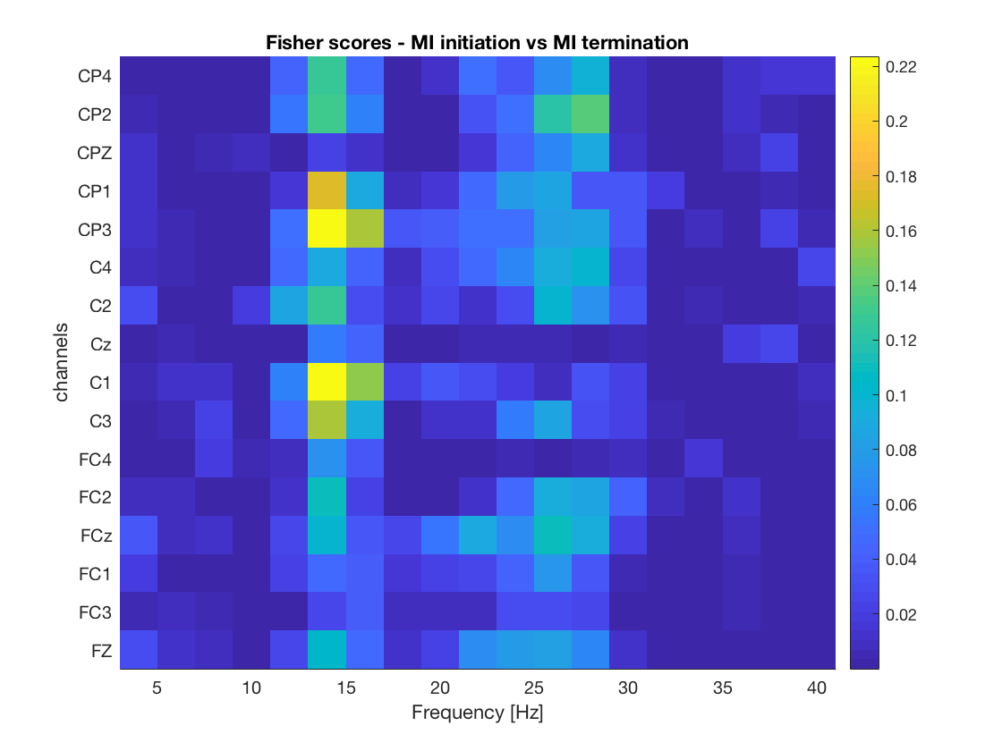
Fisher score – ak6
rankfeat on 75% (re-training on train+validation)
The most discrimant features appear to be in the mu band, for channels: C1, C3, CP1,CP3

Slide 22
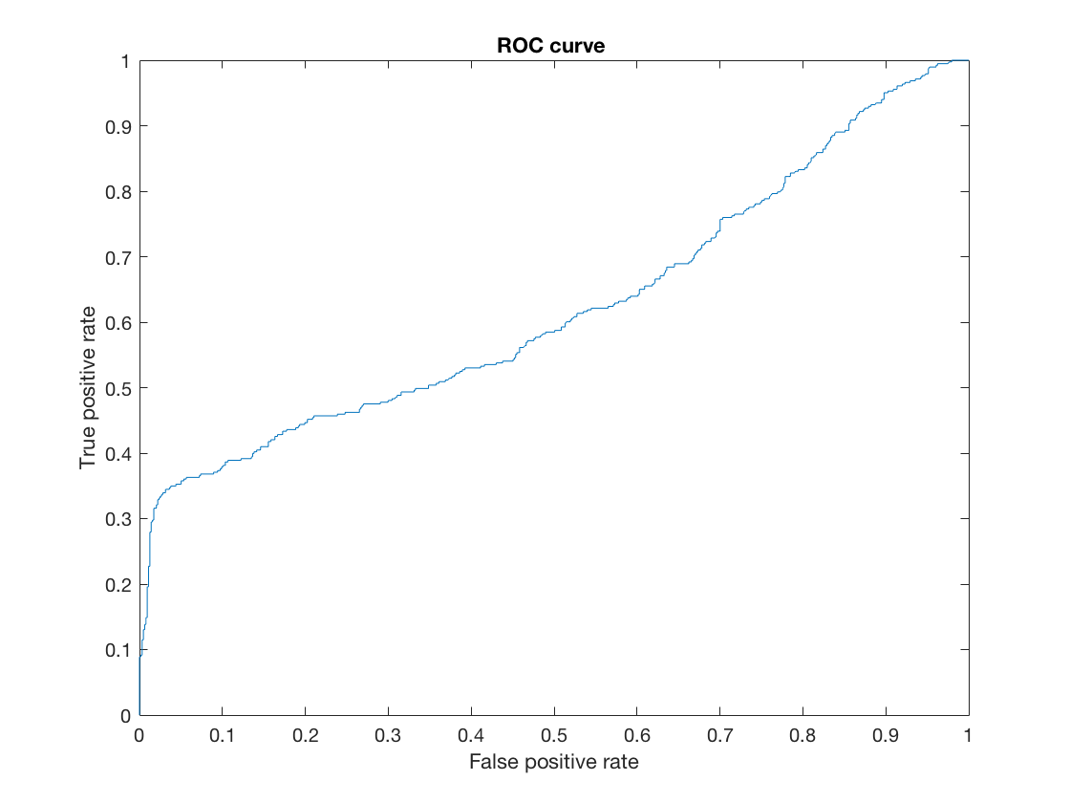
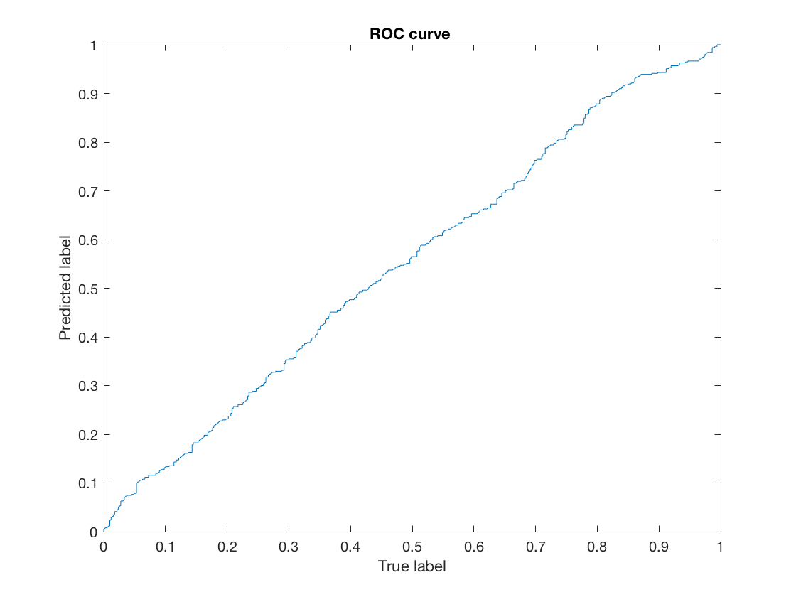
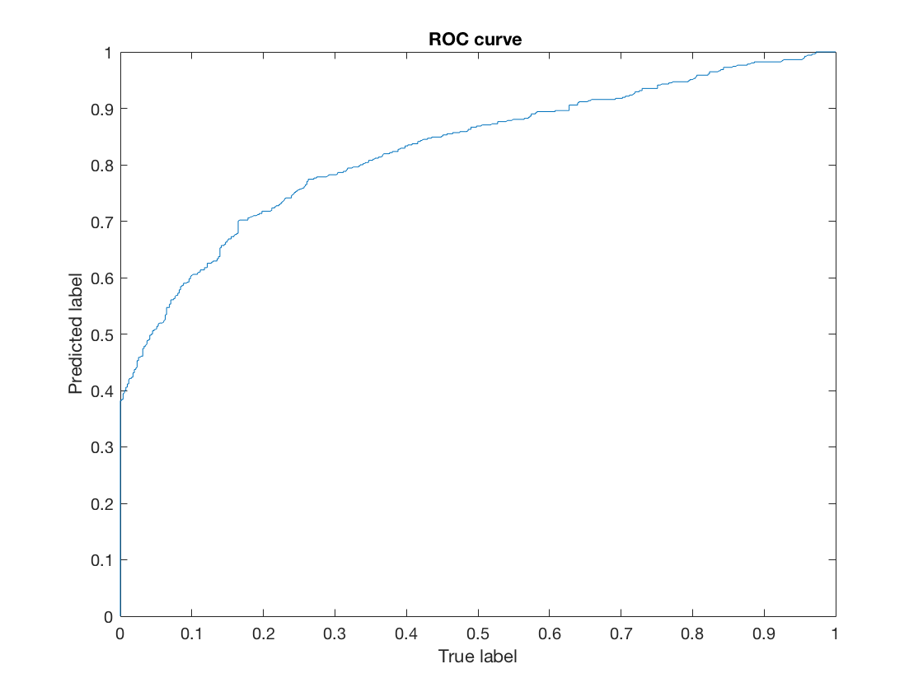
Metrics for capability assessment: ROC curves
ak4
ak5
ak6
Only the decoder for subject ak6 shows a good performance

Slide 23
Metrics for capability assessment: class error and confusion matrix
ak4
ak5
class error: 0.362
class error: 0.463
confusion matrix:
574 | 63
239 | 144
confusion matrix:
316 | 194
278 | 232
ak6
class error: 0.238
confusion matrix:
420 | 90
152 | 358

Slide 24
Discussion

Slide 25
Summary
For all the participants the channels of interest (CP3, CP4, C3, C1) have the highest activity during MI termination
Kinesthetic Motor Imagery shows for all the participants the expected pattern of brain activity
Beta rebound is almost always accompanied by mu rebound

Slide 26
Major issues encountered
The decoder shows higher performance for one participant than other one
Mean class error over CV folds with respect to the number of features shows a monotonic decreasing trend
It is possible that some problems in re-ordering the features for Fisher’s scores maps were present in the code
Epoching

Slide 27
Other approaches which could be used
Proper PCA
Mean class error over CV folds with respect to the number of features shows a monotonic decreasing trend
It was not possible to perform quadratic classifier

Slide 28
…online!
The decoder shows higher performance for one participant than other one
Mean class error over CV folds with respect to the number of features shows a monotonic decreasing trend
It was not possible to perform quadratic classifier

Slide 29
Thank you for your attention!
Any questions?

Slide 30
Additional results

Slide 31
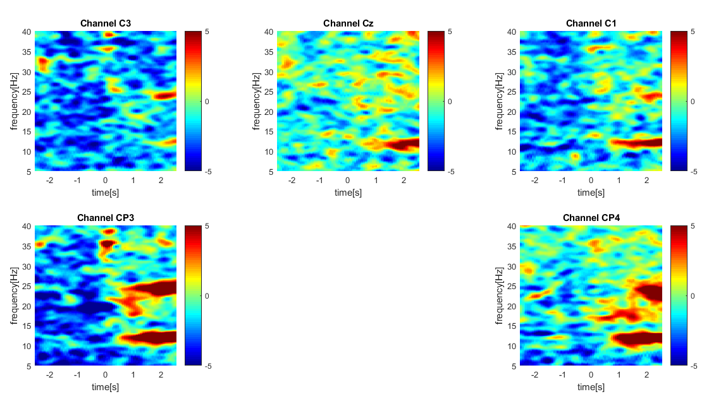
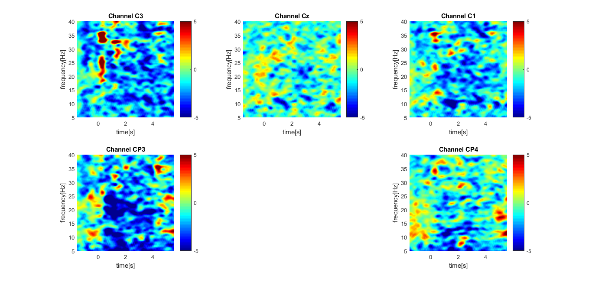
Spectrogram offset and onset CAR - ak5

Slide 32
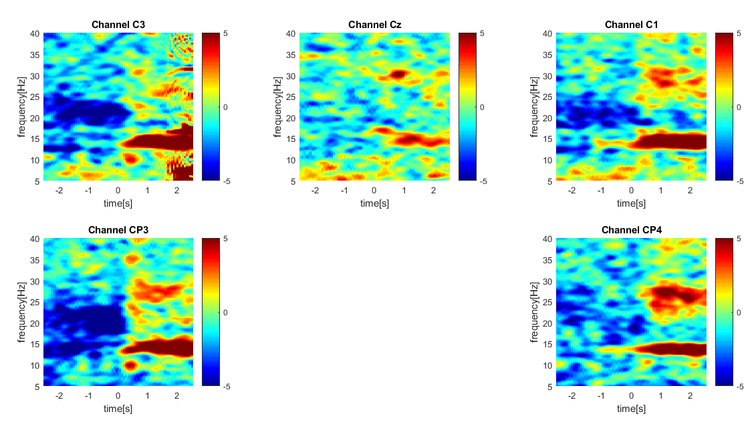
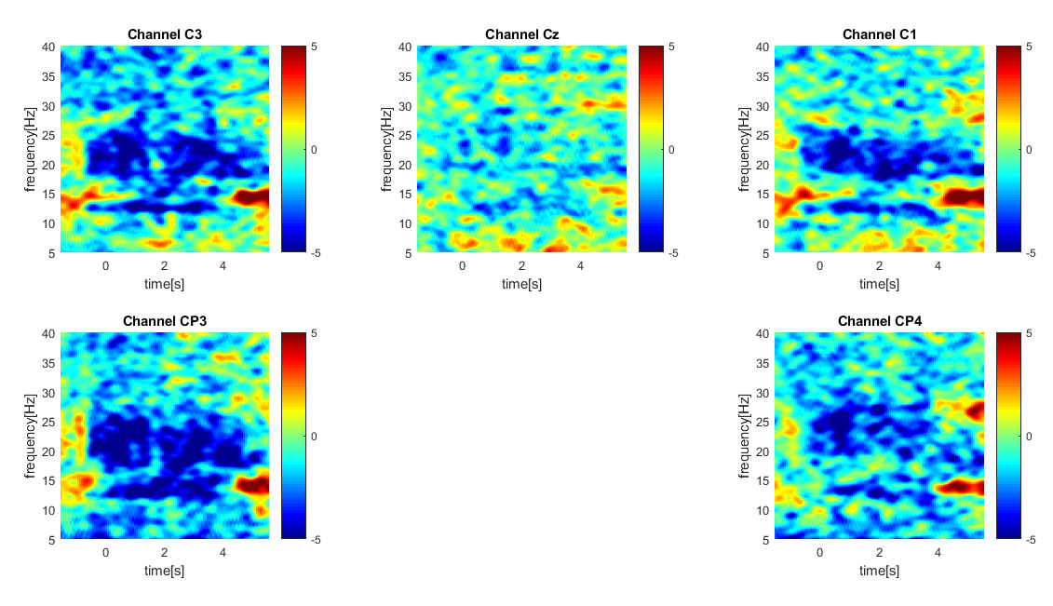
Spectrogram offset (left) and onset (right) CAR - ak6

Slide 33
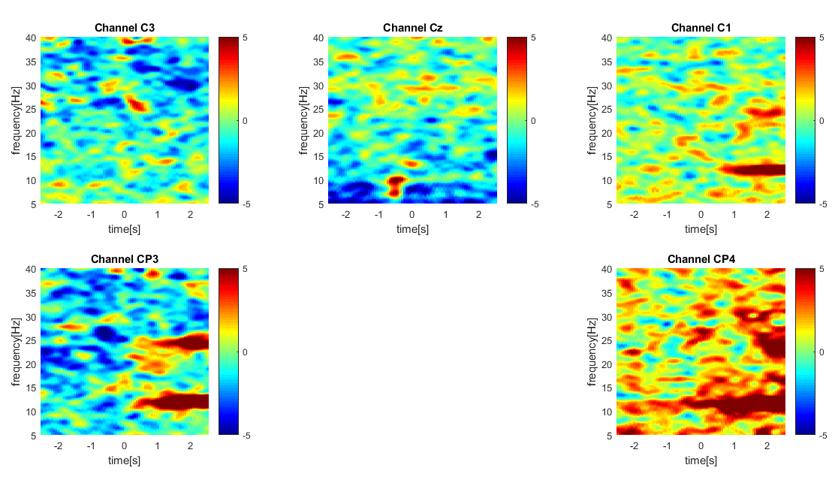
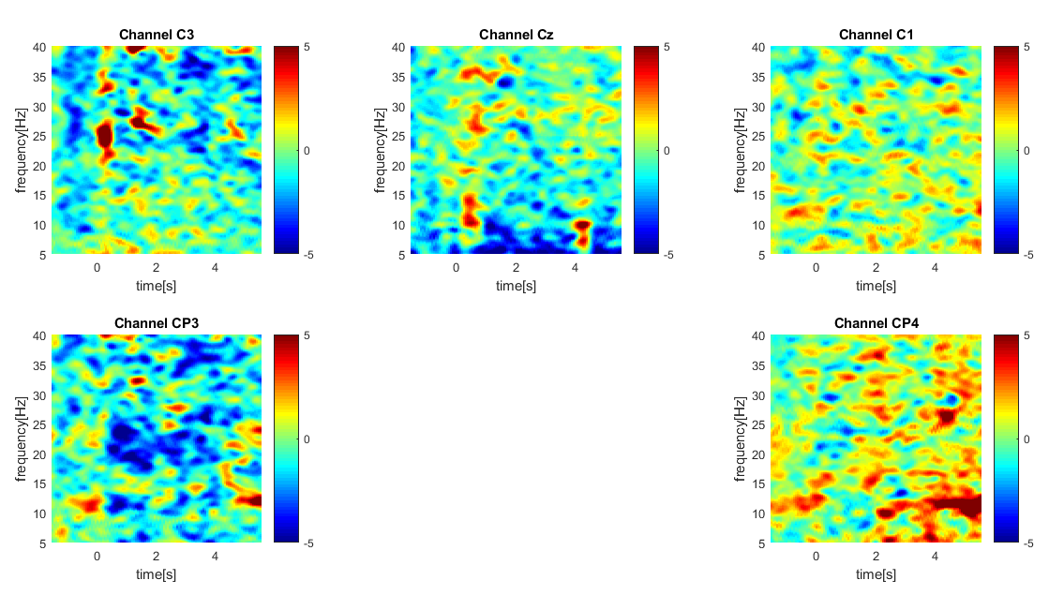
Spectrogram offset and onset Laplacian - ak5

Slide 34
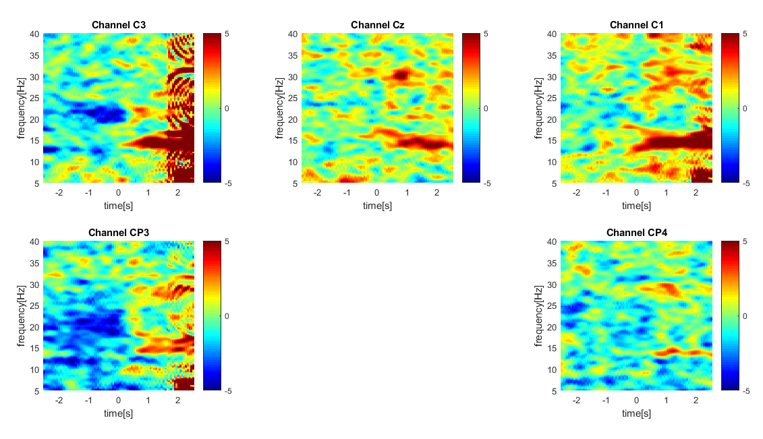
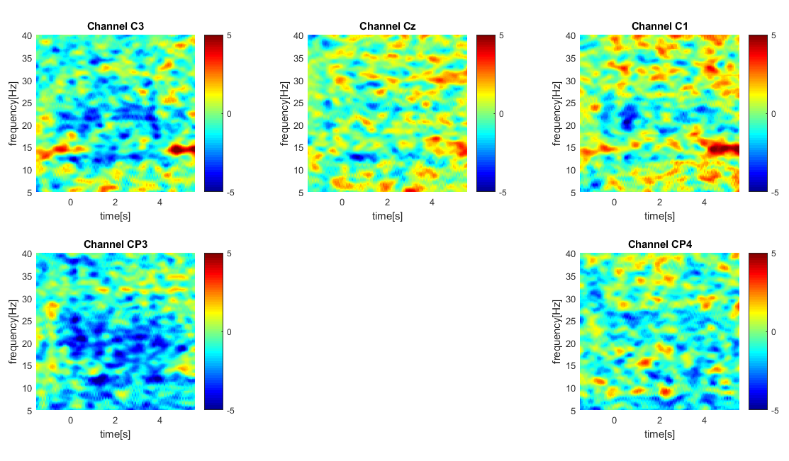
Spectrogram offset and onset Laplacian - ak6

Slide 35
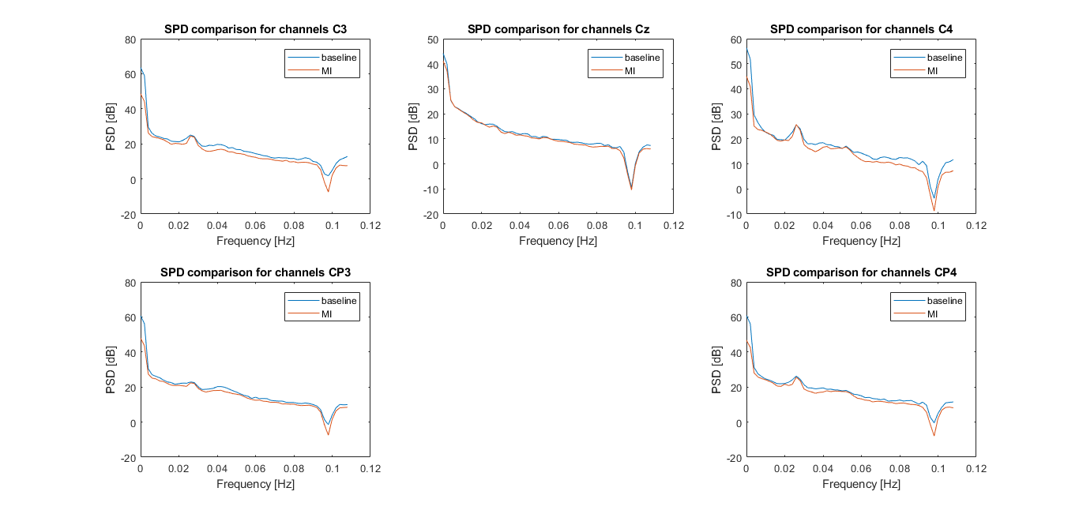
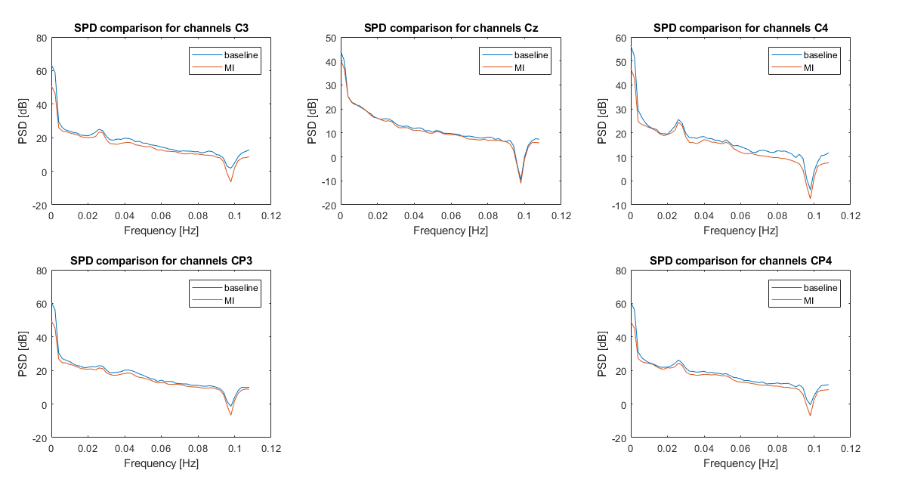
Periodogram (Pwelch) offset/onset ak6

Slide 36
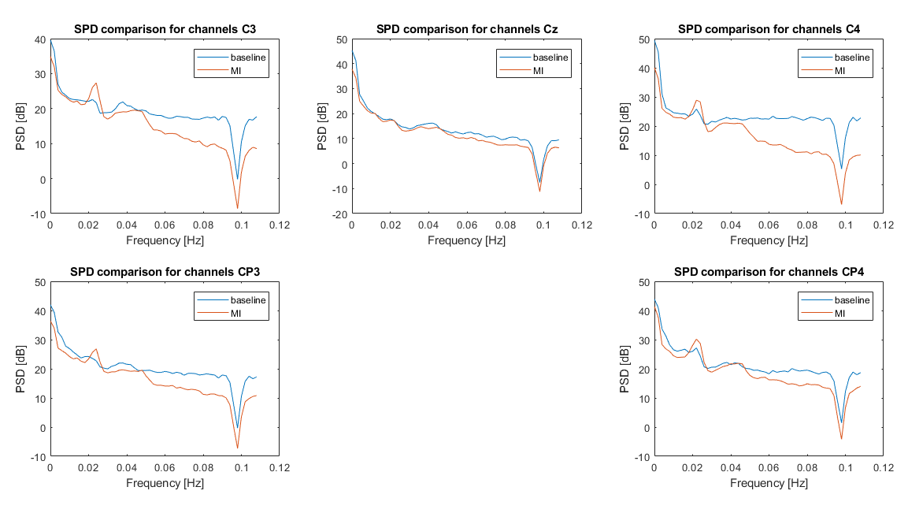
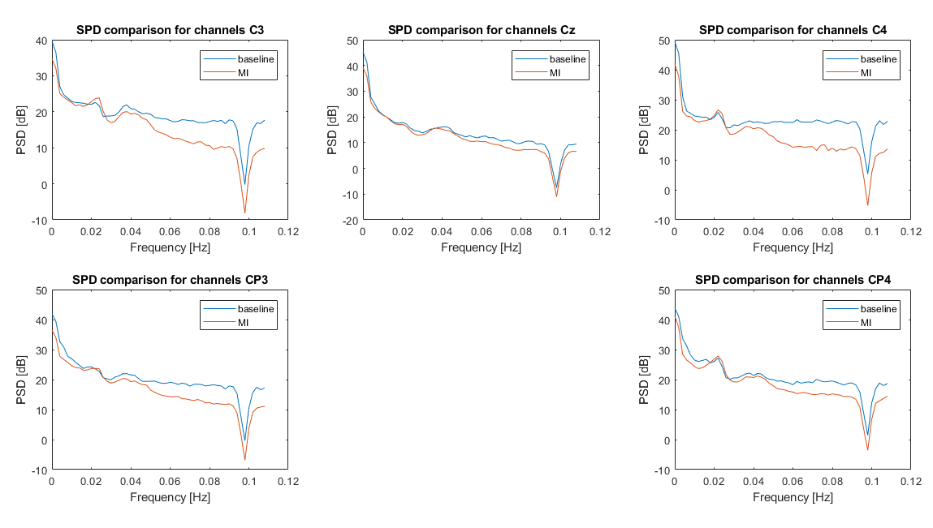
Periodogram (Pwelch) offset/onset ak4

Slide 37
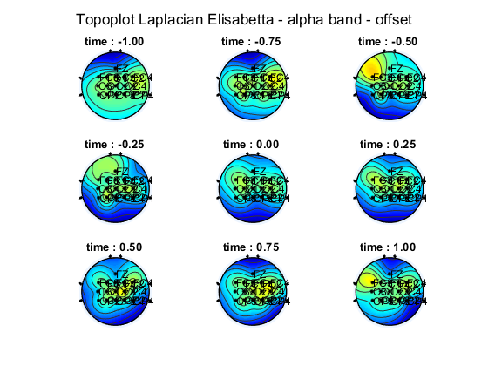
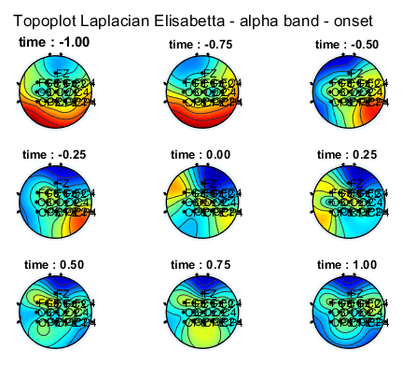
Topoplot alpha band - ak6

Slide 38
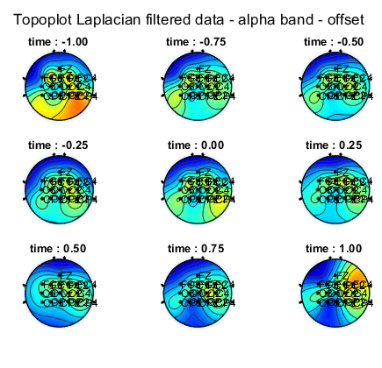
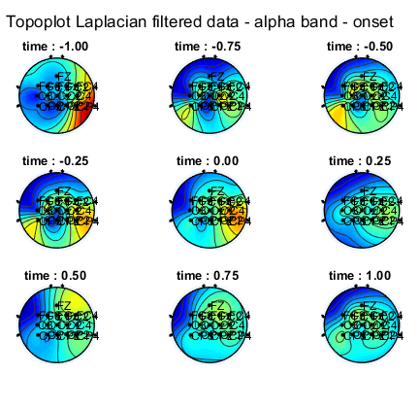
Topoplot alpha band - ak5

Slide 39
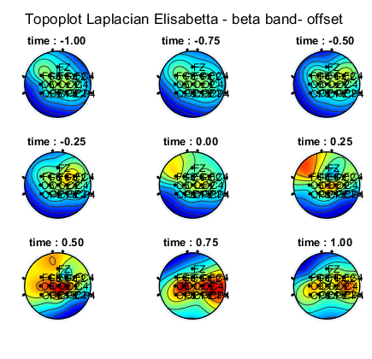
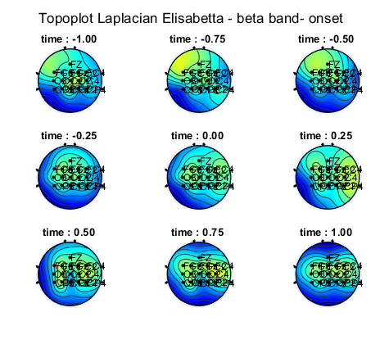
Topoplot beta band - ak6

Slide 40
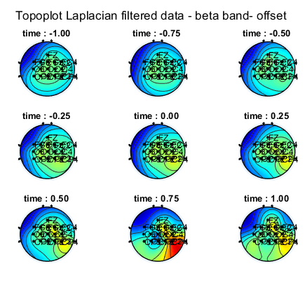
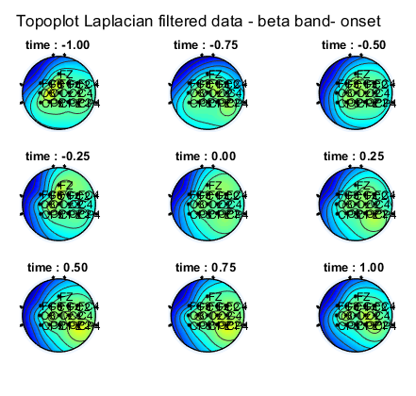
Topoplot beta band - ak5

Slide 41
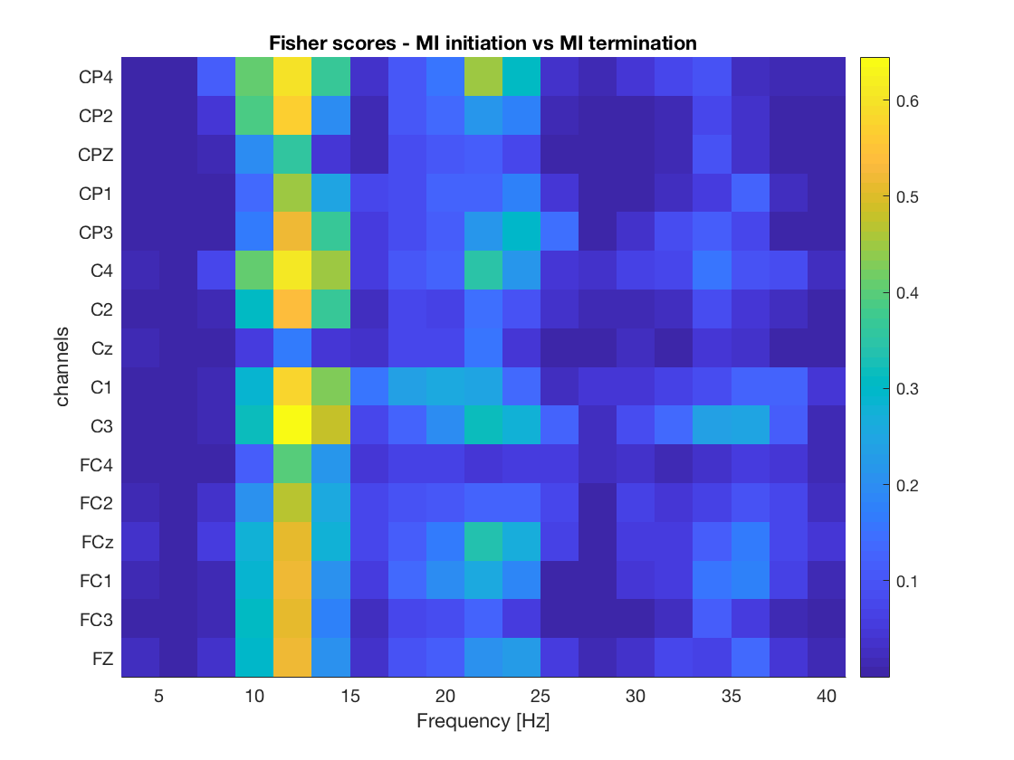
Fisher score – ak4

Slide 42
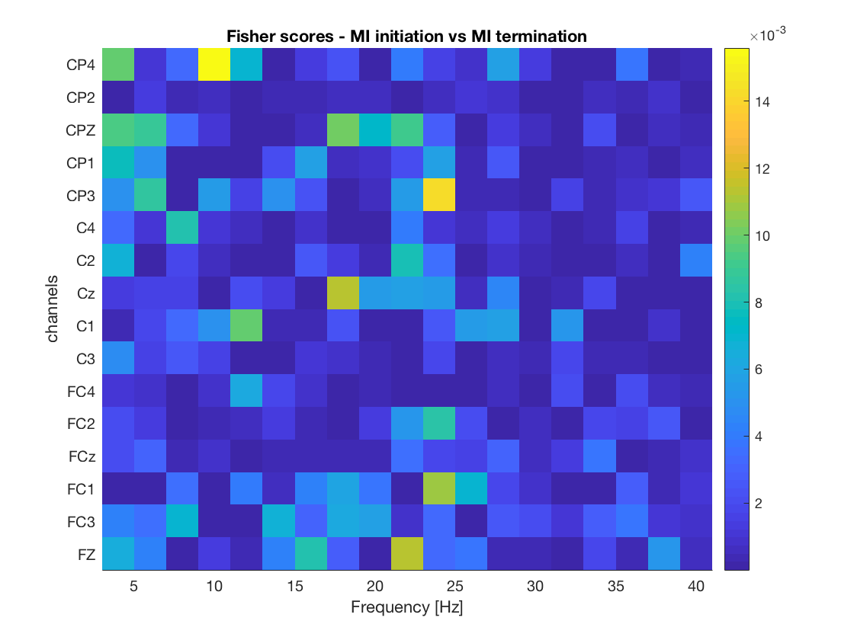
Fisher score – ak5

Slide 43
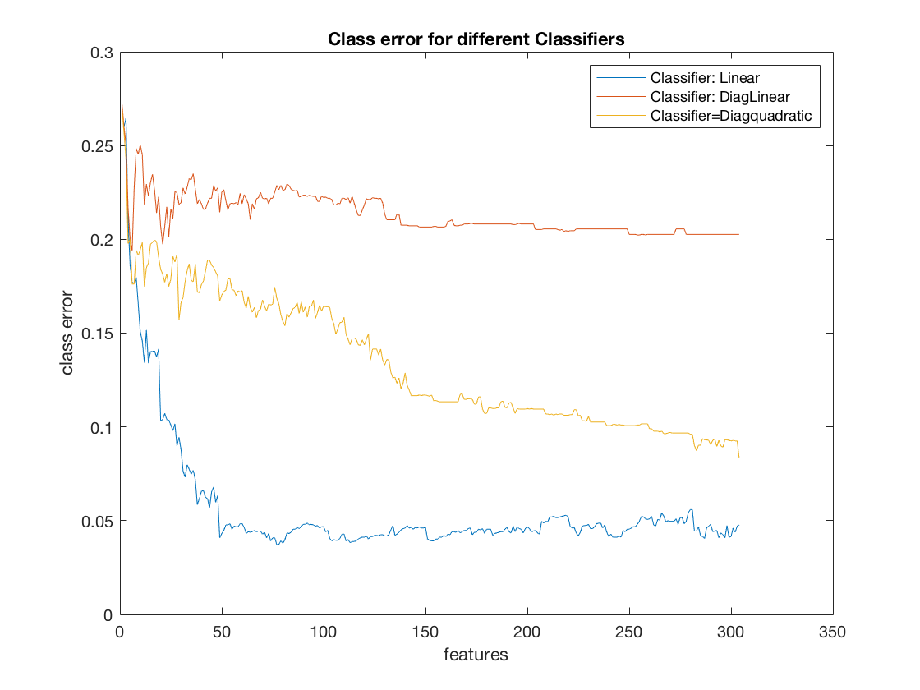
Class errors on CV folds – ak 5

Slide 44
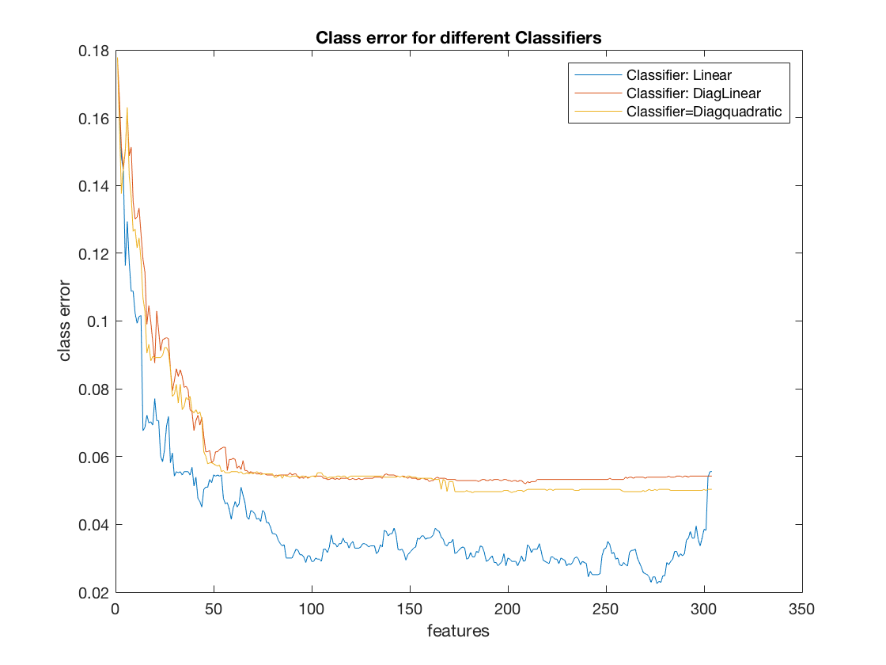
Class errors on CV folds – ak 6

